Slide 1
Robotic Flag Finder
ECE 3333/3334-302
Instructor: William Ray
Group 6: Leader - Adam
Adam Harper - Systems Engineer
Celina Luckevich - Image Process Engineer
Joseph Mahoney - Software Engineer
Joshua Warren - Comms. Engineer

Slide 2
System Description
Two robots are designed to search a room for flags, retrieve the flags, and return to their home base. The robots can work both cooperatively and competitively, each trying to find the most flags but ensuring all flags are found. They send video and location feed over a wifi network to a computer where instructions for driving the robots are derived from the video; these instructions are then sent back over the network to the robots. The system works autonomously, but a manual, human-controlled mode is also available.

Slide 3
Division of Labor
Josh
Computer Vision
Communication between Camera and OpenCV
Communication between MCUs and computer.
Celina
Rover side
Computer Vision
Image Processing and Analysis
Flag finding/Detection
Adam
Computer side
Communication between robots and computer
Communication between camera and computer
Joe
Computer side
GUI
Robotic arm

Slide 4
Last Week Deliverables
Joe
Basic Rover movement.
Power calculations
Rover cad design
Looked into Bluetooth
Josh
Research into communicating with the MSP430G2553 over bluetooth
Worked on sending commands to the rover from a computer.
Basic rover movement.
Celina
Continue learning Python
Track a specified object/target in a video feed
Adam
Research computer communication with IP Cameras
Testing camera communication

Slide 5
Safety Considerations
Avoiding short circuits, causing overheating.
Careful to operate robots at a safe speed to avoid damaging parts/people
Put up signs/barriers when driving robots
Exercise caution to avoid cuts from sharp wire ends
Covering wires when cutting to keep ends from flying
Always use proper PPE

Slide 6
Block Diagram
WIFI
Physical connection
Uart
Power
GPIO
PWM
Power
Robot #2 is identical
PC
sensors
Bluetooth
Robot #1
Ultrasonic
HC-SR04
Wifi Camera
External rechargeable battery
CC3220
MCU
mechanical
3.3 V
5 V
3.3V
3.3 Volt
Regulator
5 V Voltage
Regulator
9.6v
9.6V
4000mAh
9.6 V
9 V Voltage
Regulator
3.3v
Data Computation
3.3v 50 Hz
Dagu - Rover 5 chassis motors
5 V Voltage
Regulator
HS-422
Survo
Uxcell 9V 50N
Electromagnet
Circuits
7.2 V
H-Bridge
Joe Mahoney

Slide 7
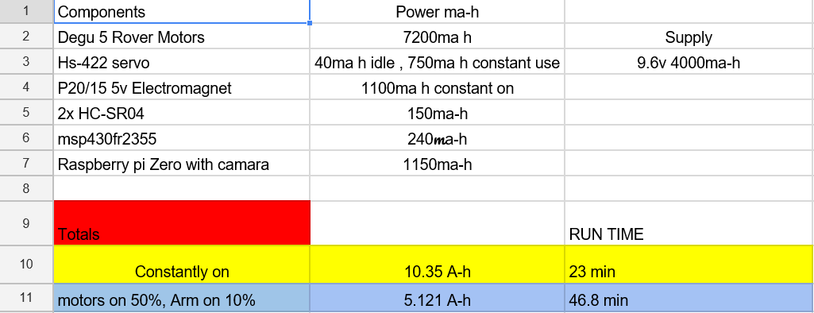
Power Budget
Joe Mahoney

Slide 8
Development approach
Establish Internet Connection
Stream video and Pass data
Connect to a Master Code on a computer
Communicate with board on Rover
Recognize objects through camera
Isolate and center Flag
Build second Rover
Get rover moving
Add sensors and arm
Develop different modes of operation

Slide 9
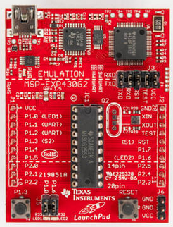
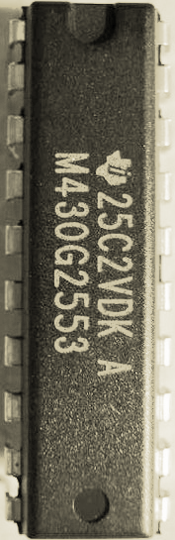
Texas Instruments MSP430G2553
Will interact with BlueSMiRF to receive commands from computer
Can be put into low power mode to conserve battery
16 Bit RISC CPU
16 KB Flash
512 B RAM
All info from TI [5]

Slide 10
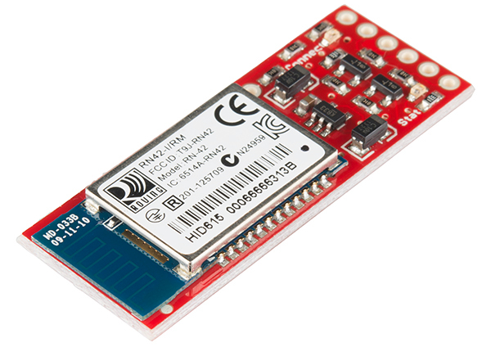
SparkFun Bluetooth Modem - BlueSMiRF
Operating Voltage: 3.3-6 V
Operating Current: 3-30 mA
BAUD Rate: 2400 - 115200 bps
Range: 20 M
FCC Approved
All info from Sparkfun [7]

Slide 11
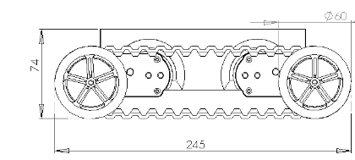
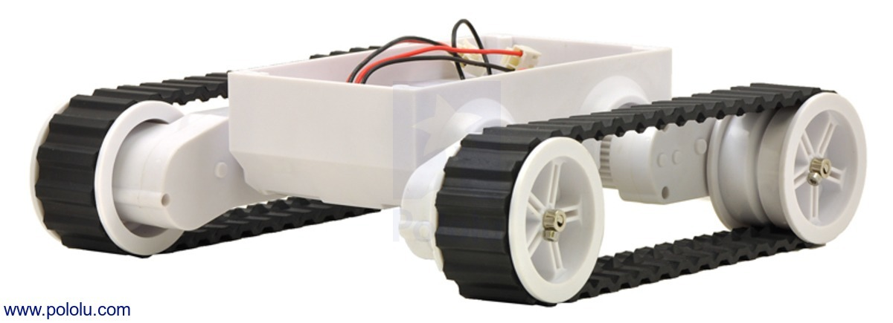
Rover Base
Dagu Rover 5
Motor Rated Voltage: 7.2V
Motor Stall Current: 2.5A
Motor Stall Torque: 10Kg/cm
Motors have 1000/3 encoders
Speed: 1Km/hr
All info from Pololu [4]

Slide 12
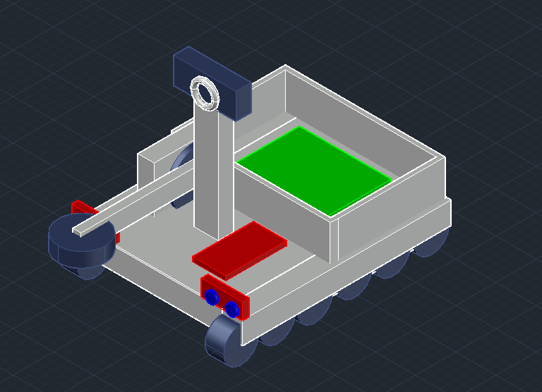
Proposed Rover layout
Joe Mahoney

Slide 13
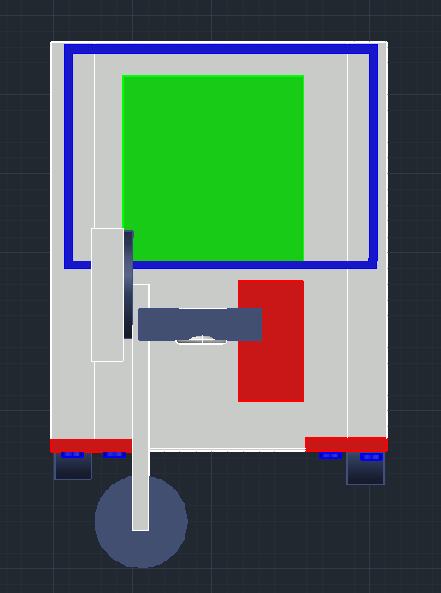
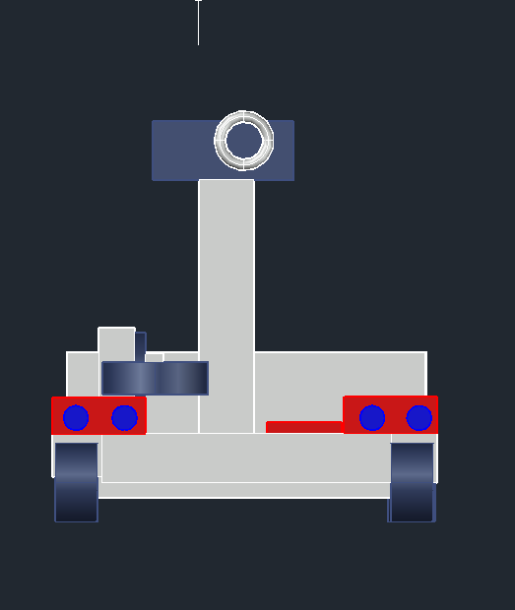
Rover Layout (Top/Front)
Joe Mahoney

Slide 14
Arm Components
Servo motor - HS-422
Operating voltage 4.8 V - 6 V
8mA Idle current drain
.21sec/60 degrees
Electromagnet - uxcell 9V 50N Electric Lifting Magnet
Holding force 50N / 11.2 pound force
Joe Mahoney

Slide 15
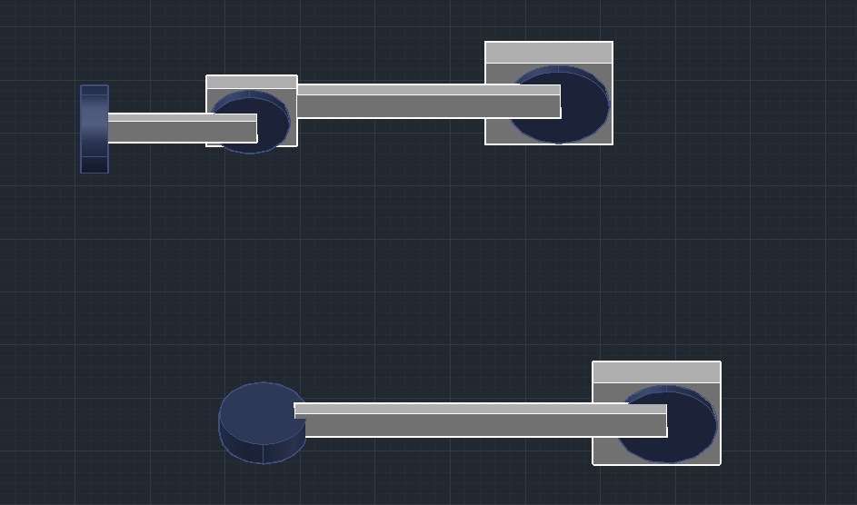
Arm Design
Current design plan is to use a single servo.
Additional joints may be necessary.
Joe Mahoney

Slide 16
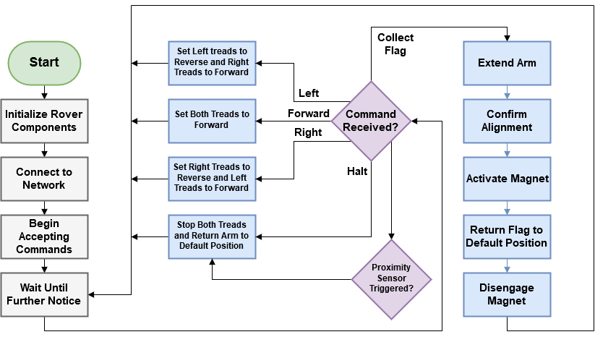
Rover Software Diagram

Slide 17
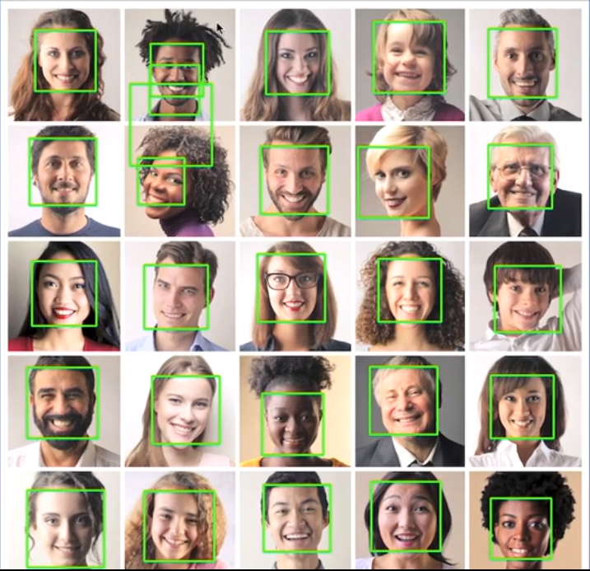
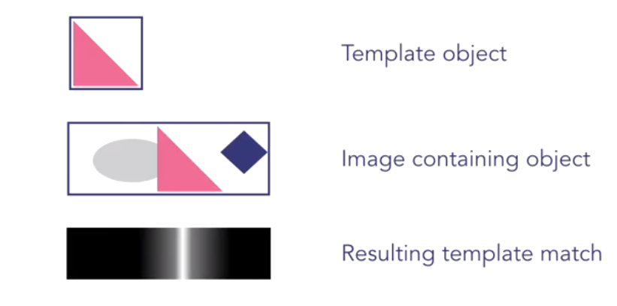
Computer Vision
Camera will be used on rover in order to accomplish task
OpenCV has video analyzing features allowing us to scan the rovers surroundings for the flags it is looking for
Different kinds of filters
Usually coded in python
[1]
[1]

Slide 18
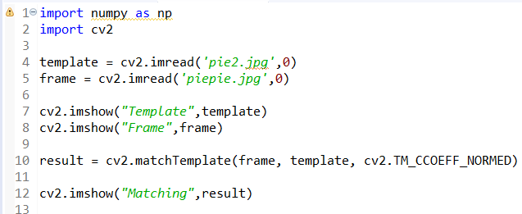
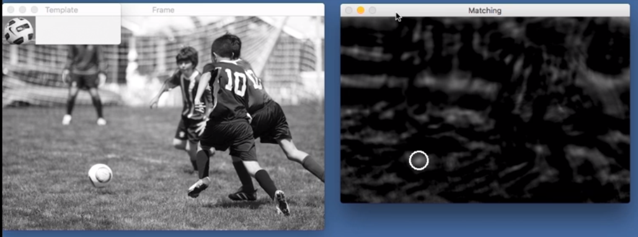
Template Matching
[1]

Slide 19
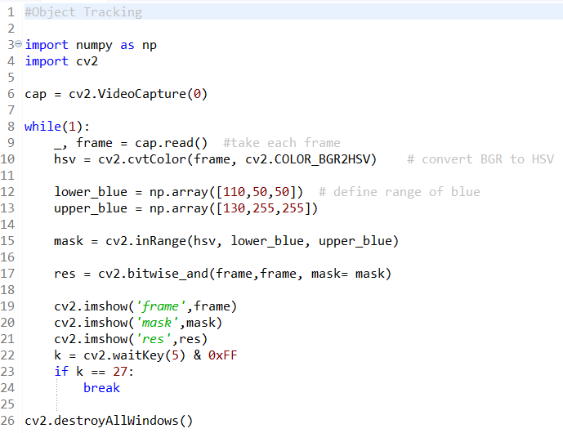
Object Tracking
www.openCV.org
Different sorts of filters/tracking
Color filters
Shape filters
Iterative location
MeanShift
CAMShift

Slide 20
Looking for Colors
Orange - RGB[255,128,0]
Hue = 30, Hue Adjusted = 15
HSV L[5,50,50] H[25,255,255]
Yellow - RGB[255,255,0]
Hue = 60, Hue Adjusted = 30
HSV L[20,50,50] H[40,255,255]
Green - RGB[0,255,0]
Hue = 120, Hue Adjusted = 60
HSV L[50,50,50] H[70,255,255]
Cyan - RGB[0,255,255]
Hue = 180, Hue Adjusted = 90
HSV L[80,50,50] H[100,255,255]
Blue - RGB[0,0,255]
Hue = 240, Hue Adjusted = 120
HSV L[110,50,50] H[130,255,255]
Purple - RGB[255,0,255]
Hue = 300, Hue Adjusted = 150
HSV L[140,50,50] H[160,255,255]
Red - RGB[255,0,0]
Hue = 360, Hue Adjusted = 180
HSV L[170,50,50] H[180,255,255]

Slide 21
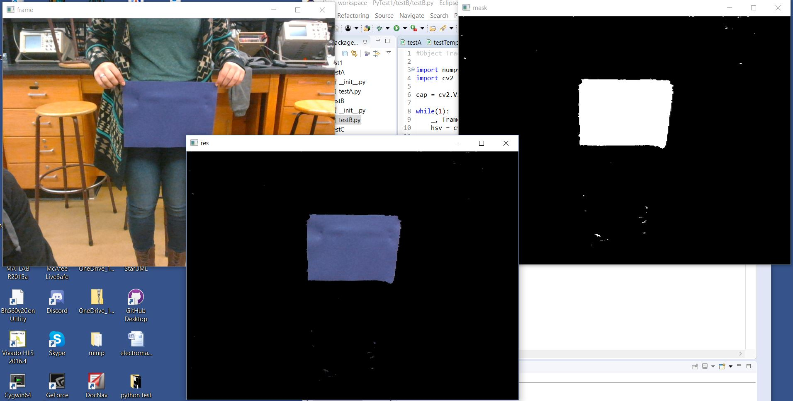

Slide 22
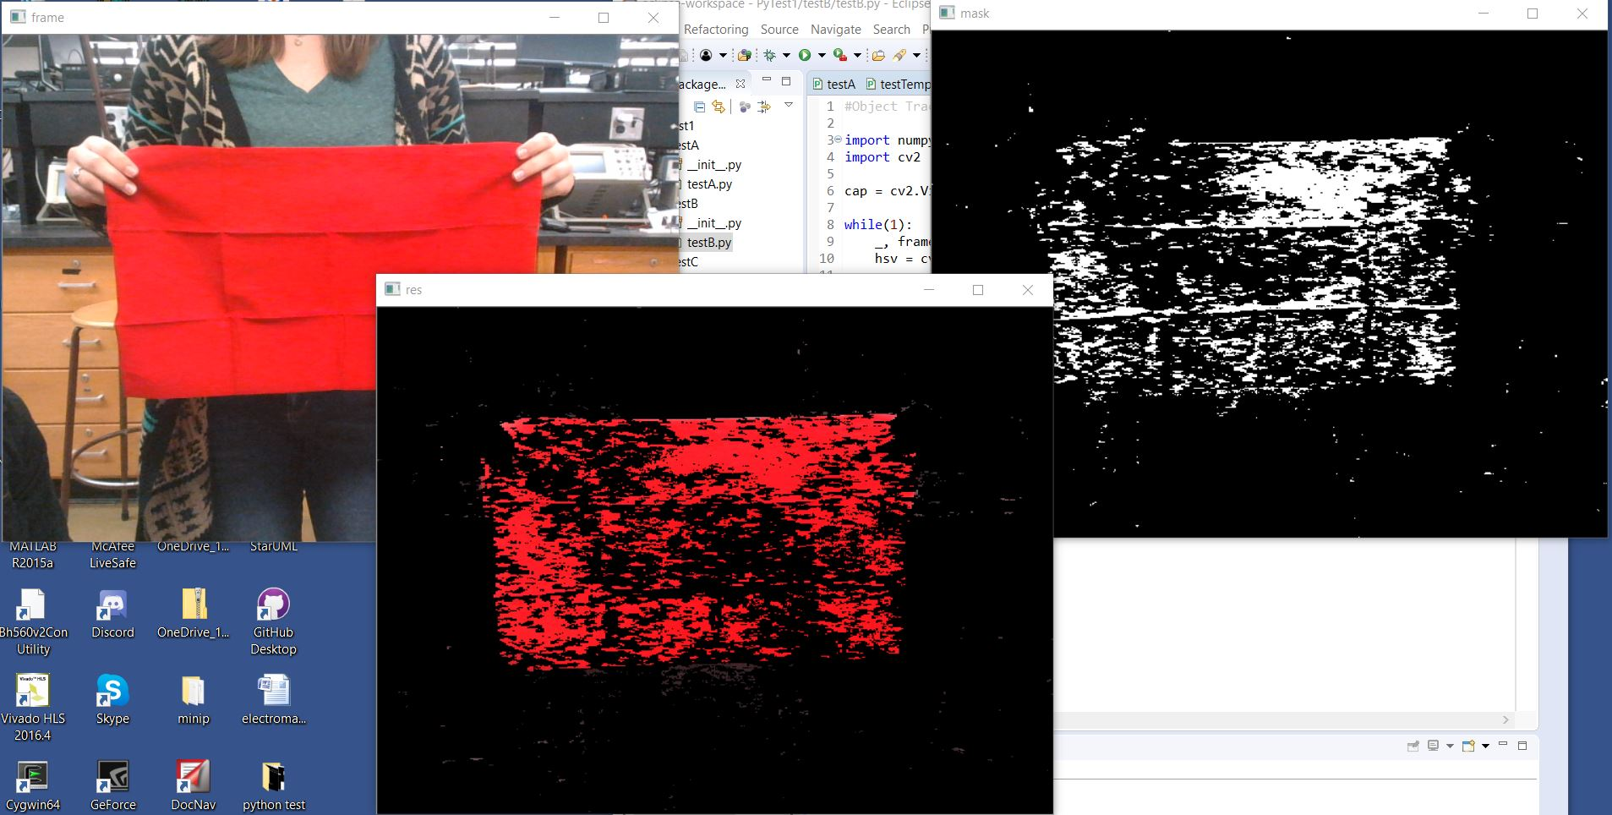

Slide 23
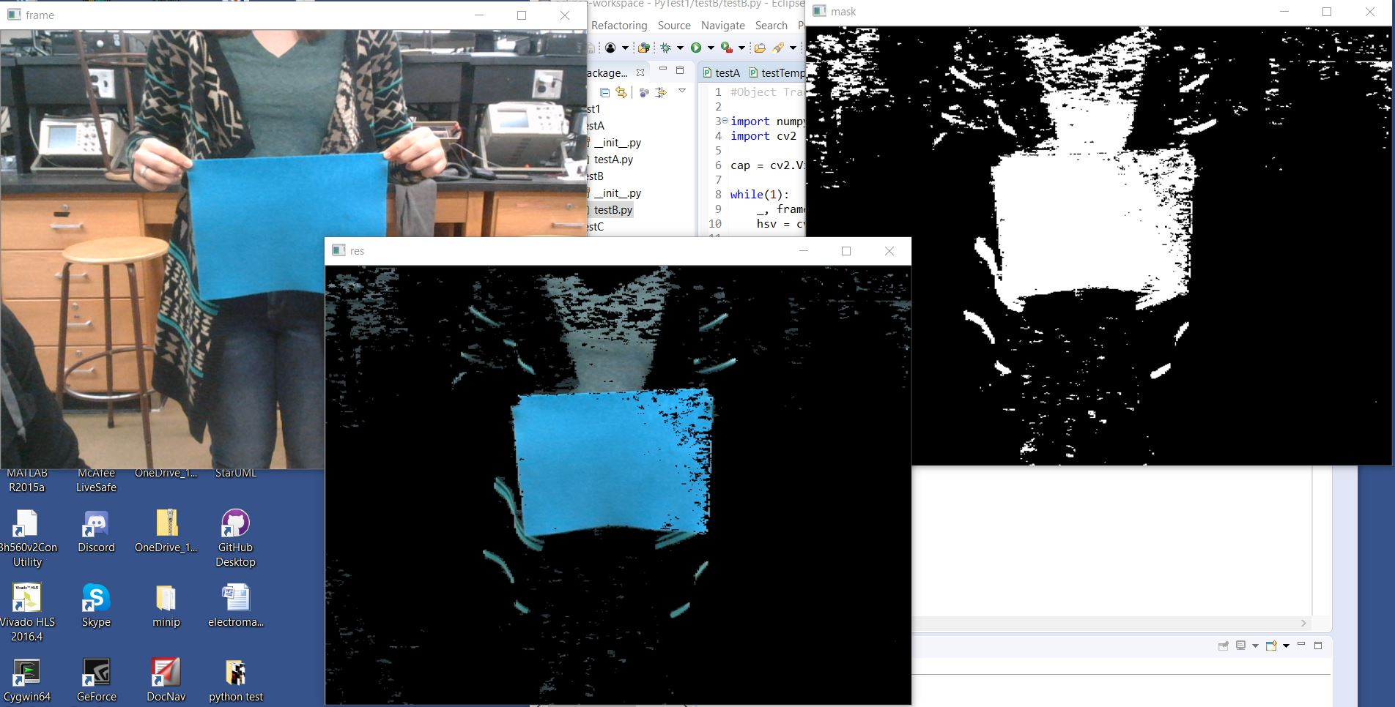

Slide 24
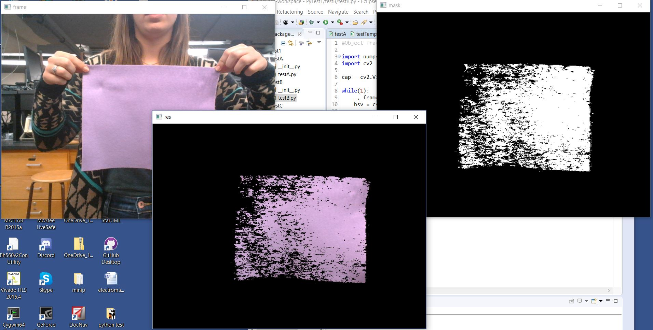

Slide 25
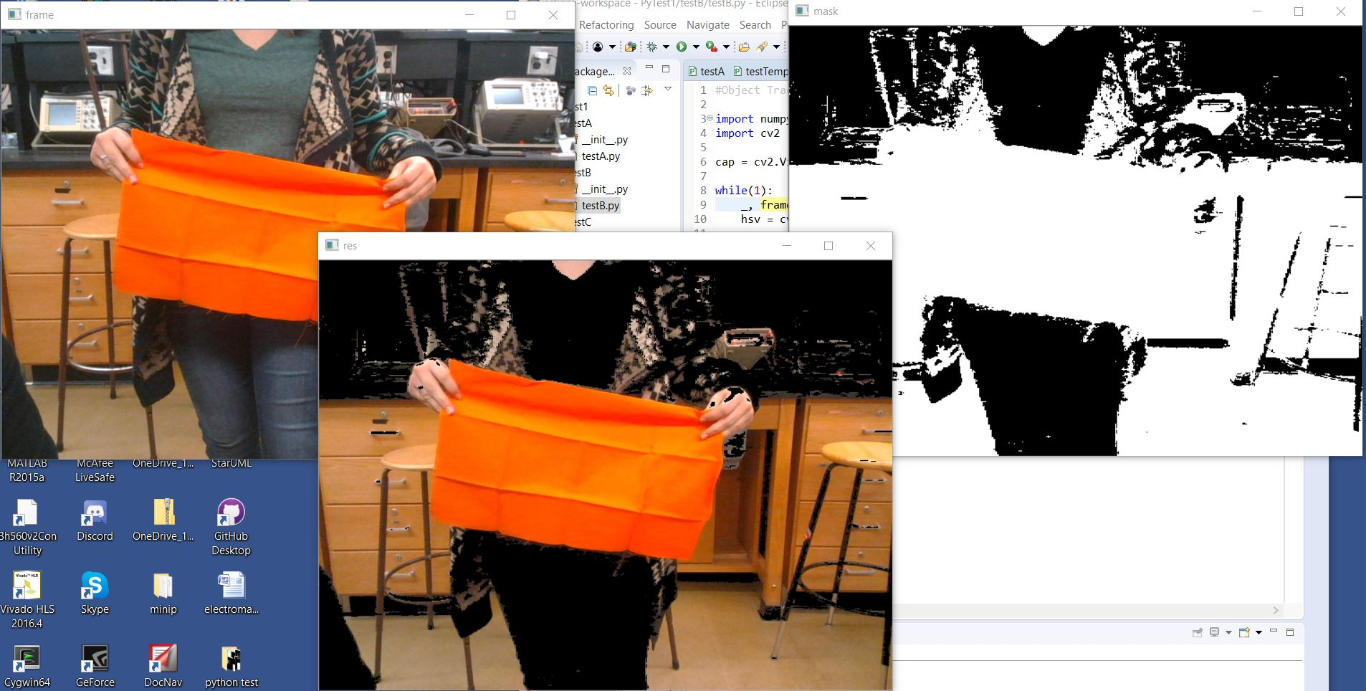

Slide 26
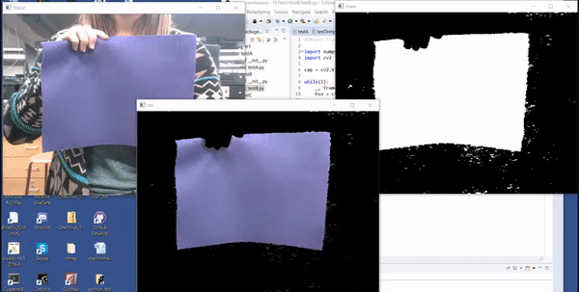

Slide 27
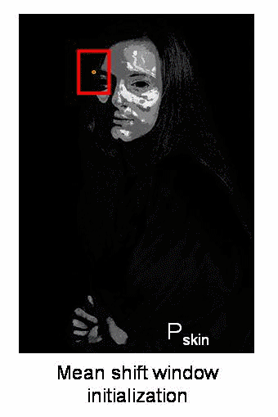
Next Step
Camshift - Continuously Adaptive Mean shift
Uses iteration to center in on hottest part of heat map of target colors
Once centered, uses algorithms to match shape of target object
Can find object by color no matter the size as affected by distance
[8]

Slide 28
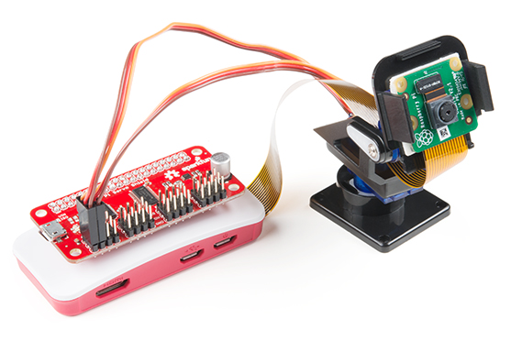
Camera
Sparkfun Raspberry Pi Zero
Raspberry Pi Camera module V2
802.11 b/g/n wireless LAN
2.4 GHZ band
Bandwidth up to 54 Mbps
1080p video needs 22 Mbps
Bluetooth 4.1
[9]

Slide 29
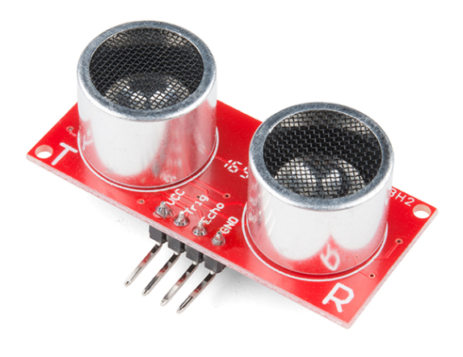
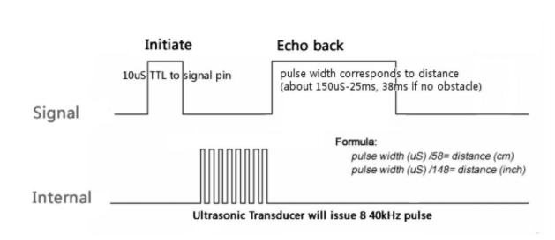
Ultrasonic Sensor - HC-SR04
Operating Voltage: 5V DC
Operating Current: 15mA
Measure Angle: 15°
Ranging Distance: 2cm - 4m
[2]
Range = uS / 58 -> centimeters
Range = uS / 148 -> inches
Range = high level time * velocity (340M/S) / 2
[2]
[3]

Slide 30
GUI - Python
Python GUI maker: tkinter (built-in)
Must use Python Image Library (PIL) for video feed
PIL contains tools for drawing text, windows, shapes, etc.
OpenCV stores images in BGR order; PIL needs RGB

Slide 31
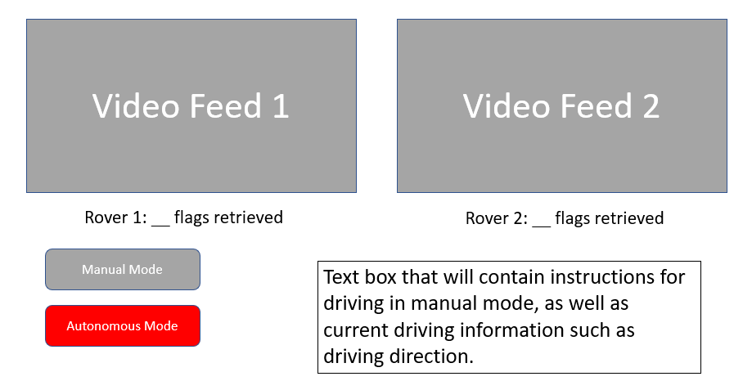
GUI Design

Slide 32
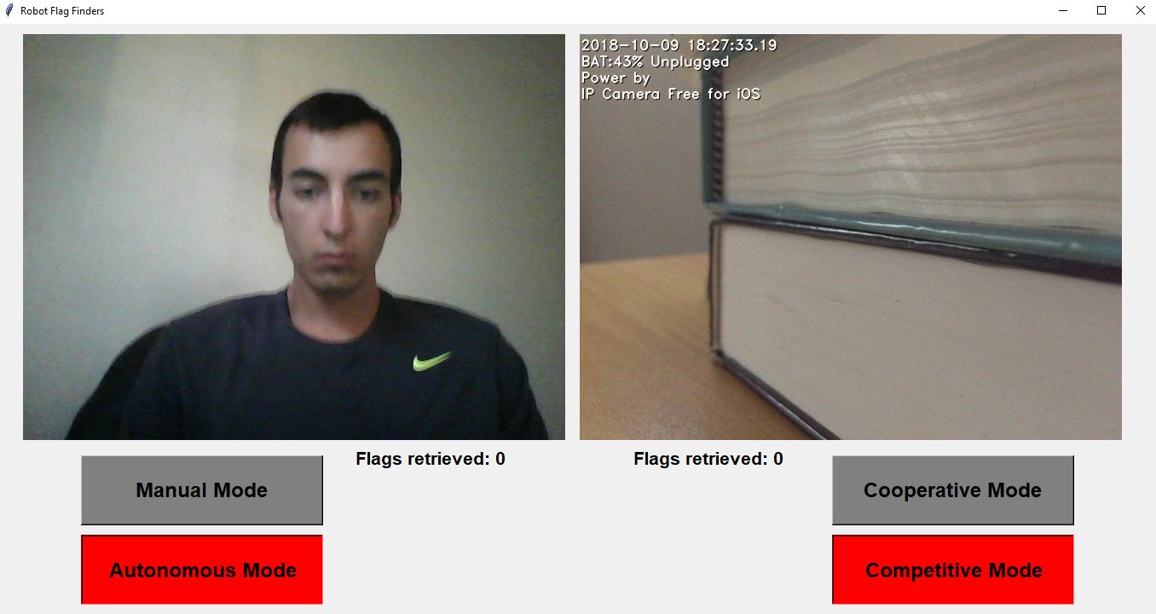
GUI

Slide 33
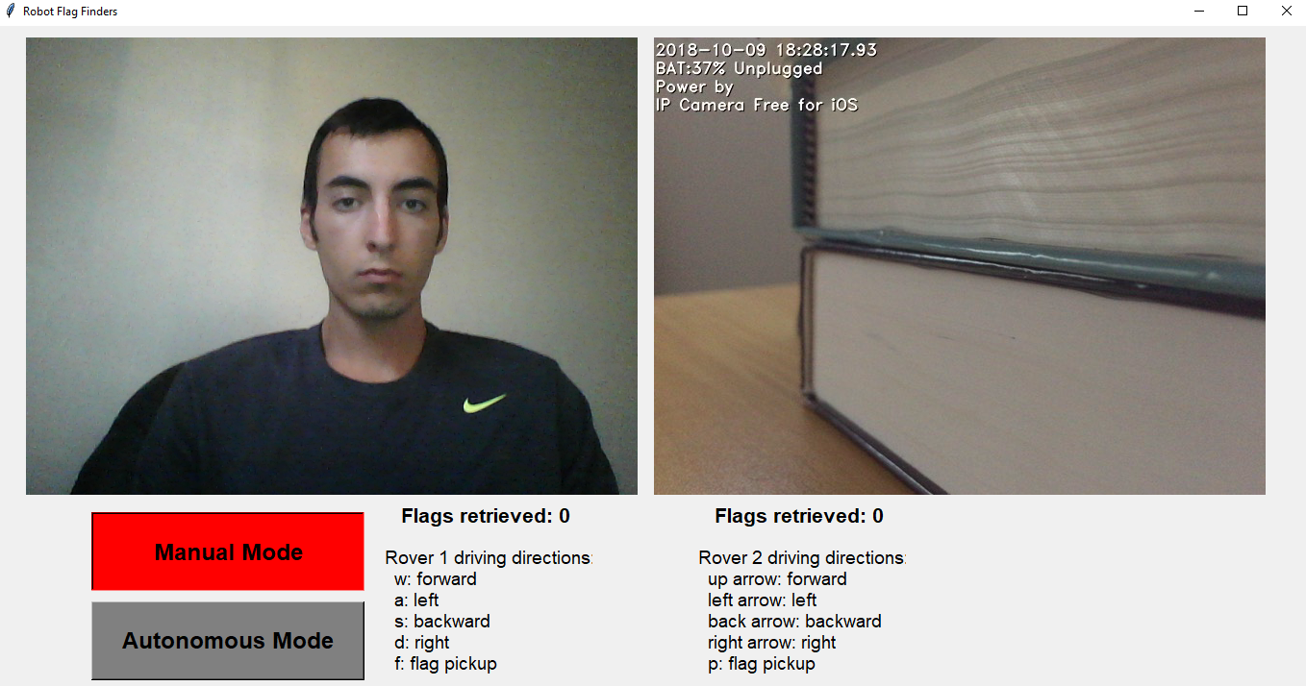
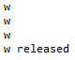
GUI

Slide 34
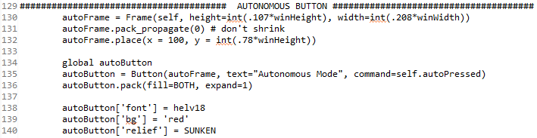
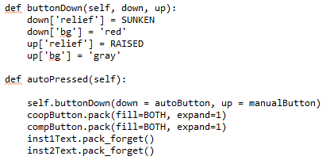
GUI

Slide 35
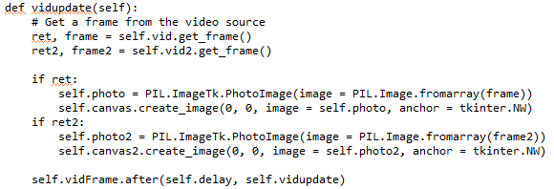
GUI - video

Slide 36
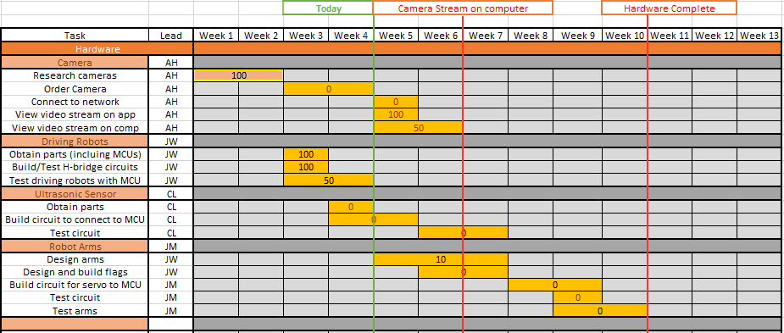
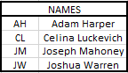
Gantt Chart - Hardware

Slide 37
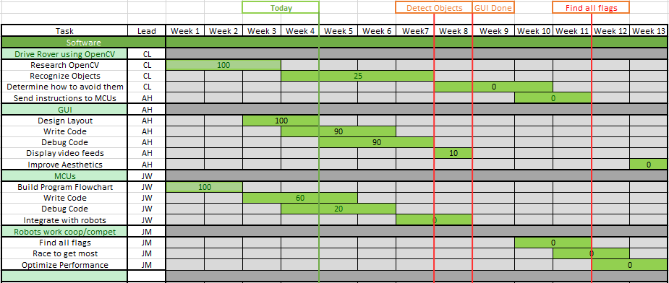
Gantt Chart - Software

Slide 38
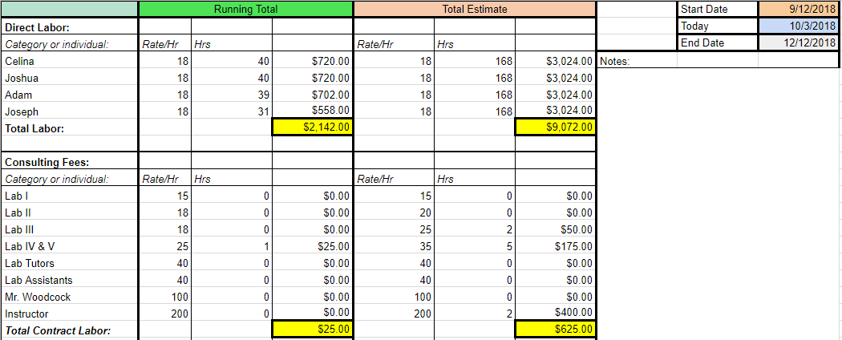
Budget

Slide 39
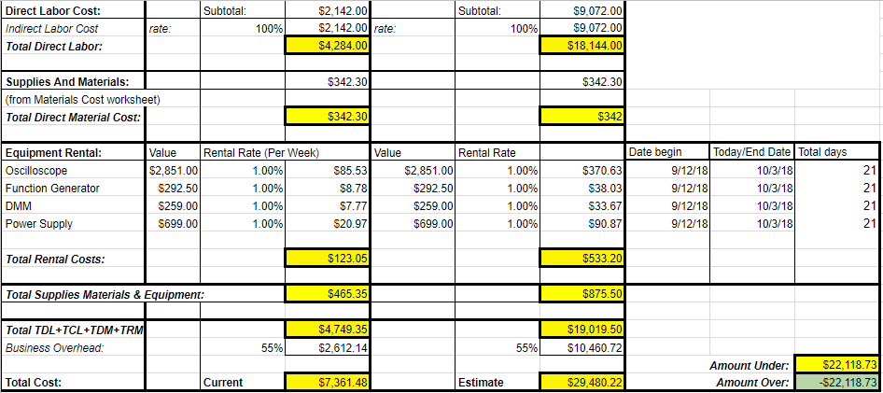
Budget

Slide 40
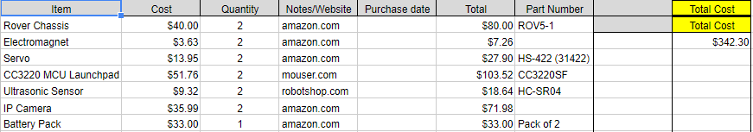
Budget - Materials

Slide 41
Next Week Deliverables
Josh
Send commands to rover through bluetooth.
Celina
Track a specified color and object/target in a video feed
Build flag prototype
Order camera
Adam
Develop method for GUI and main code to interact
Complete camera to computer communication
Joe
Work on rover manual control mode and arm.

Slide 42
References
Crawford, P. (2017). Introduction to template matching. [online] Lynda.com - from LinkedIn. Available at: https://www.lynda.com/Python-tutorials/Introduction-template-matching/601786/660495-4.html [Accessed 21 Sep. 2018].
Sparkfun.com. (2018). Ultrasonic Sensor - HC-SR04 - SEN-13959 - SparkFun Electronics. [online] Available at: https://www.sparkfun.com/products/13959 [Accessed 23 Sep. 2018].
ITead Studio. (2018). Ultrasonic ranging module : HC-SR04 data sheet. [online] Available at: https://www.electroschematics.com/wp-content/uploads/2013/07/HC-SR04-datasheet-version-2.pdf [Accessed 24 Sep. 2018].
Pololu.com. (2018). Dagu Rover 5 Tracked Chassis with Encoders. [online] Available at: https://www.pololu.com/product/1551/resources [Accessed 24 Sep. 2018].
TI.com. (2018). MSP430G2 LaunchPad Development kit. [online] Available at: http://www.ti.com/tool/MSP-EXP430G2 [Accessed 6 Oct. 2018].
Docs.opencv.org. (2018). OpenCV: Changing Colorspaces. [online] Available at: https://docs.opencv.org/3.1.0/df/d9d/tutorial_py_colorspaces.html [Accessed 1 Oct. 2018].
SparkFun.com. (2018) SparkFun BlueTooth Modem - BlueSMiRF [online] Available at: https://www.sparkfun.com/products/12577 [Accessed 6 Oct. 2018].
Fr.wikipedia.org. (2018). Camshift. [online] Available at: https://fr.wikipedia.org/wiki/Camshift [Accessed 10 Oct. 2018].
Sparkfun.com. (2018). SparkFun Raspberry Pi Zero W Camera Kit - KIT-14329 - SparkFun Electronics. [online] Available at: https://www.sparkfun.com/products/14329 [Accessed 10 Oct. 2018].

Slide 43
Questions?

